Slide 1
GitHub
Felicia Badillo
Maria Casal-Dominguez
Steven London
February 24, 2020

Slide 2
Definitions
First we need to know what is “version” and “version control system”
A version is a modification of your file (i.e. could be source code)
A version control system (VCS) is a system that controls the versioning of the contents of the file
In the case of Git, it takes “snapshots” of your entire project and stores them as versions
With the help of these snapshots, you can compare and go back to previous versions.

Slide 3
What is Git?
It is a distributed version-control system (VCS) for tracking changes in file contents
Major use: source code during software development.
Git is not an acronym. Linus Torvalds developed Linux and he called it so. Then he developed version control system for it and named it “Git”, which is an offensive English slang meaning “a stupid person”.

Slide 4
What is Git?
Torvalds turned over maintenance on 26 July 2005 to Junio Hamano, a major contributor to the project.
It is designed for coordinating work among programmers, but it can be used to track changes in any set of files.
Goals: speed, data integrity, and support for distributed, non-linear workflows.

Slide 5
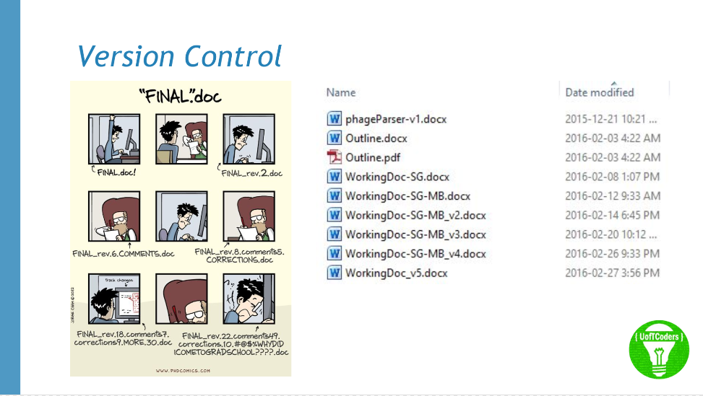
Why Git?

Slide 6
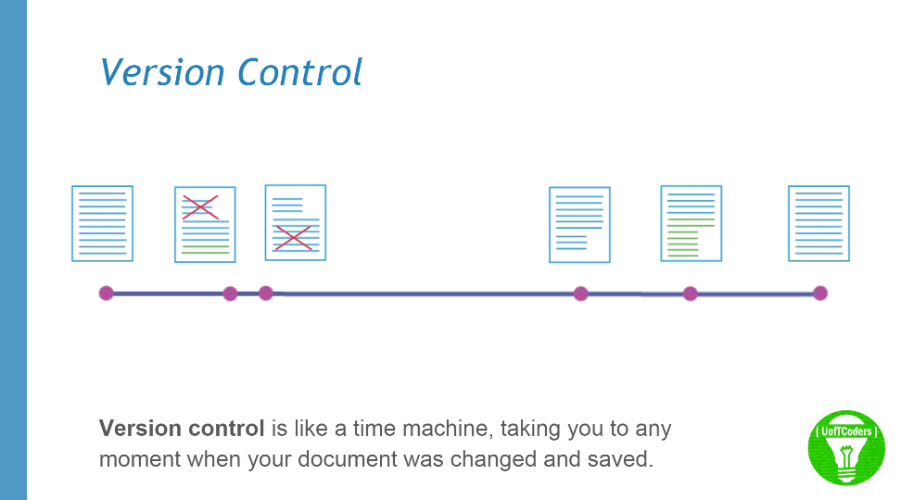
What is Git?

Slide 7
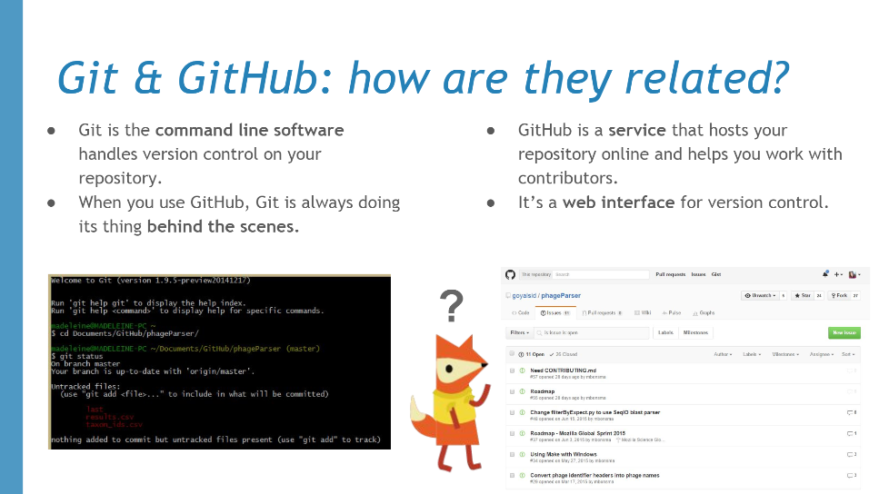
What is Git and GitHub?

Slide 8
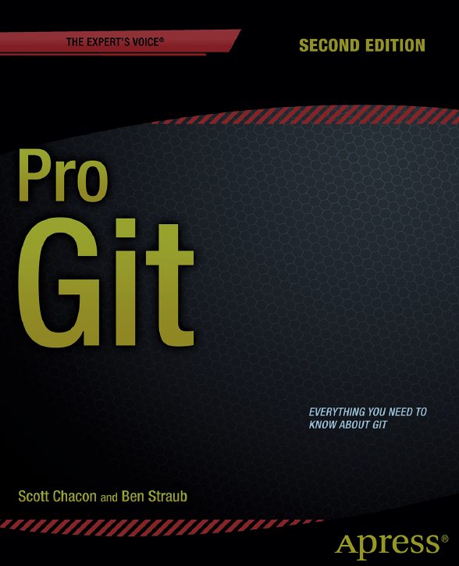
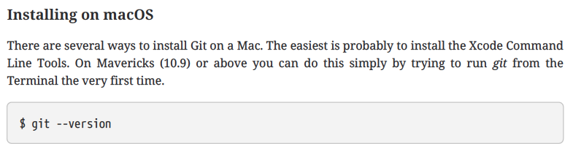
Definitions
Git - uses Git command line tools
Command line is only place you can run all Git commands
Are many GUI interfaces
Most only implement a partial subset of Git functionality for simplicity

Slide 9
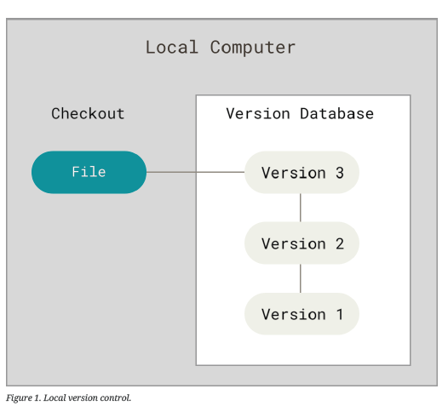
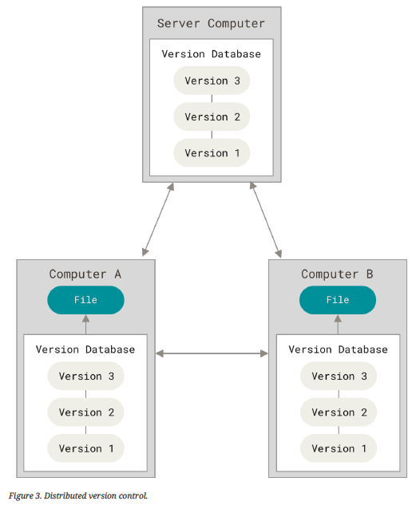
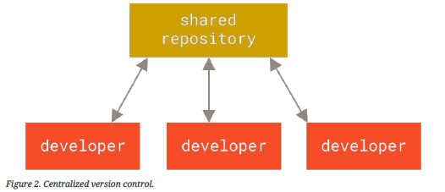
Types of Version Control

Slide 10
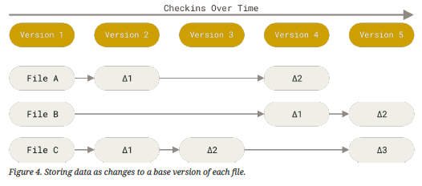
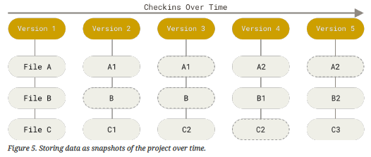
Git = Snapshots (not differences)

Slide 11
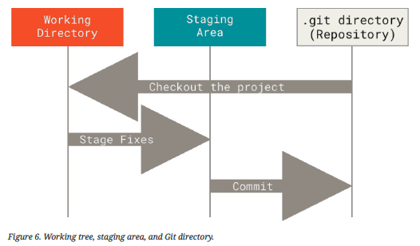
Using Git
Nearly every operation is local
Git has integrity
Everything is checksummed before it is stored → SHA-1 hash
Git generally only adds data
Git has three states that files “reside” in
Modified
Staged
Committed

Slide 12
Using Git
Git has three states that files “reside” in
Modified – you have changed the file but have not committed it to your database yet
Staged – you have marked a modified file in its current version to go into your next commit snapshot
Committed – the data is safely stored in your local database

Slide 13
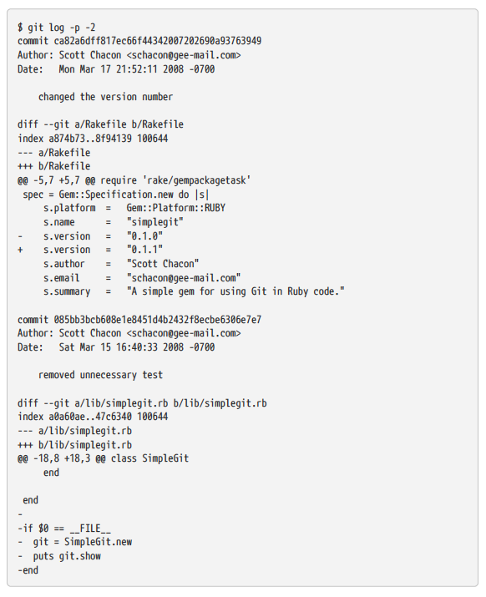
Command Line
An example

Slide 14
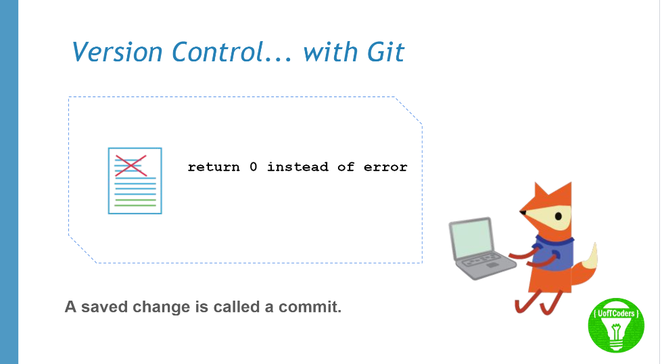
Git Features
https://github.com/UofTCoders/studyGroup/blob/gh-pages/lessons/git/intro/philosophy_of_git.pd

Slide 15
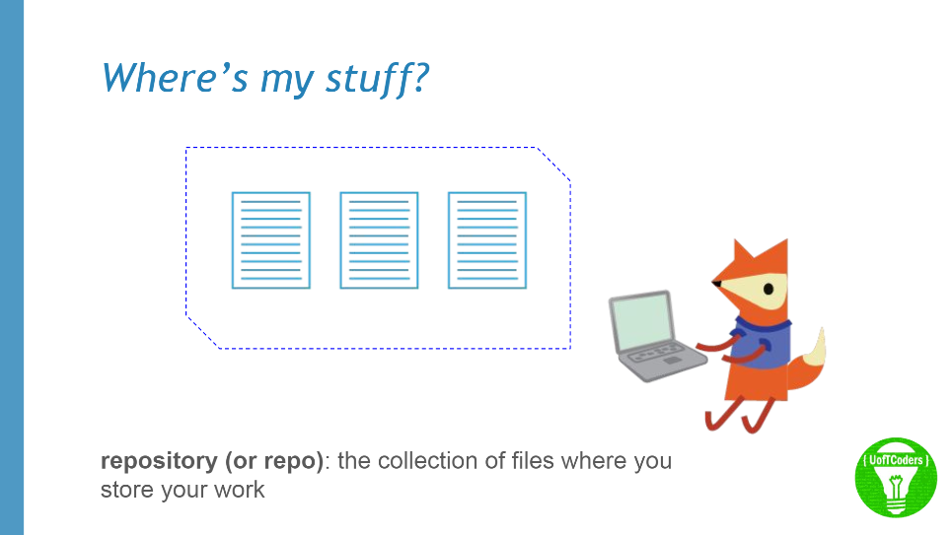
Git Features
https://github.com/UofTCoders/studyGroup/blob/gh-pages/lessons/git/intro/philosophy_of_git.pd

Slide 16
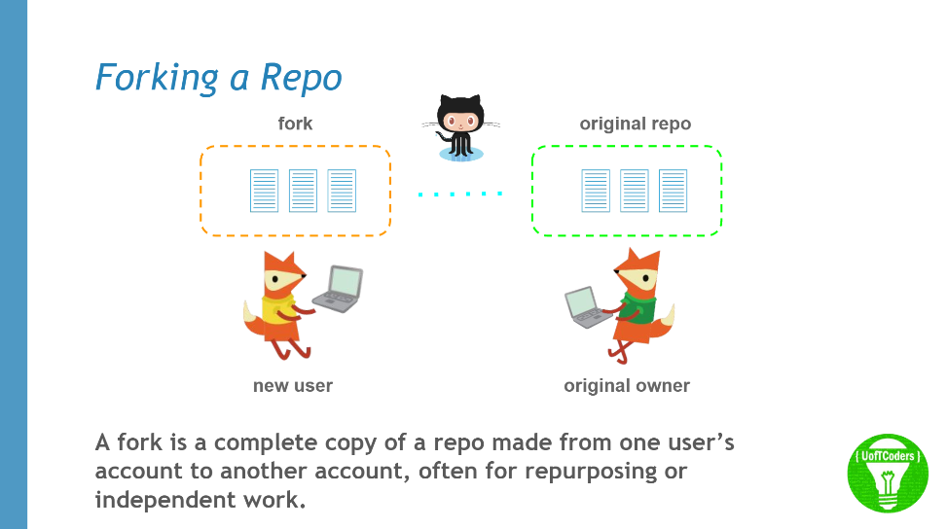
Git Features
https://github.com/UofTCoders/studyGroup/blob/gh-pages/lessons/git/intro/philosophy_of_git.pd

Slide 17
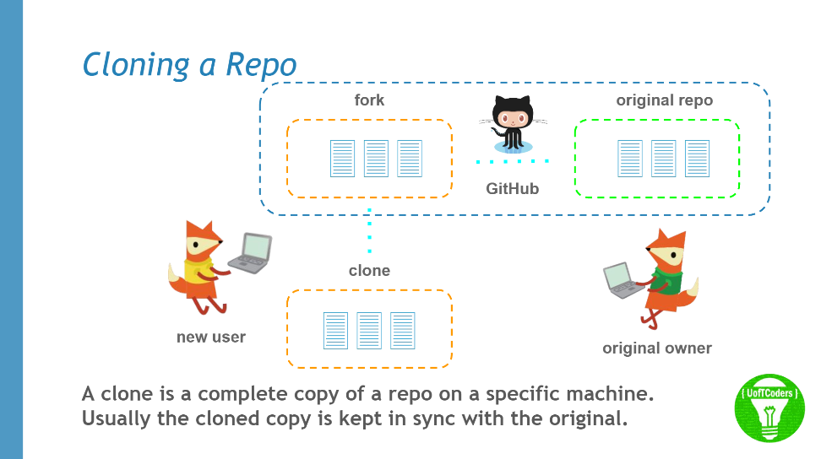
Git Features
https://github.com/UofTCoders/studyGroup/blob/gh-pages/lessons/git/intro/philosophy_of_git.pd

Slide 18
So ……..
A complicated way to deal with version control
Is it worth it ????
In my mind, now you are working with “files” that you have to track like you would do is using SAS or some other language

Slide 19
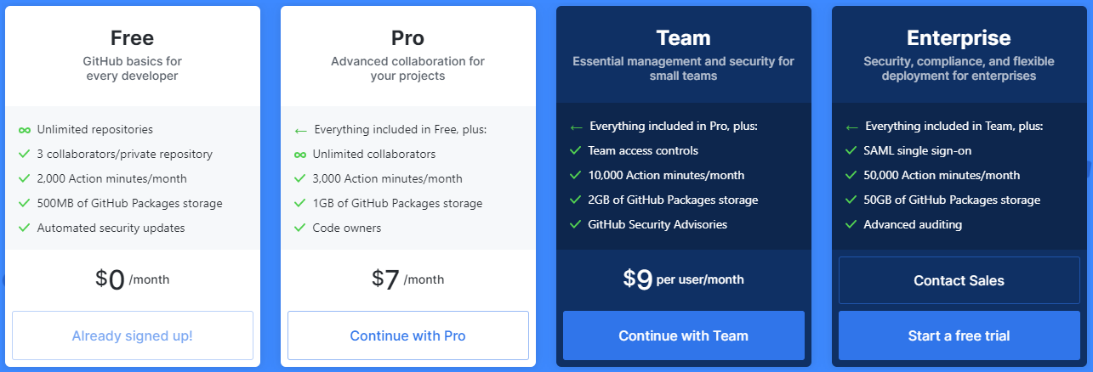
Repository Types:
Notes:
Here are the four different types of repository types, the type you choose depends on your needs, and how much you’re willing to pay! Typically, companies and organizations are the ones who would pay extra for the team or enterprise packages. Pro would be an attractive option for a serious GitHubber (one who does much GitHubbing, add that to the dictionary)

Slide 20
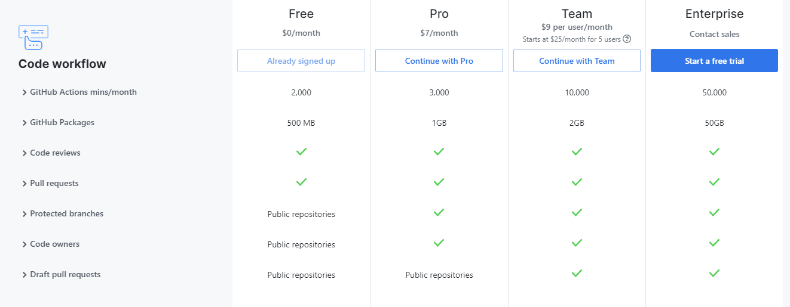
Features comparison
Notes:
As you can see, the price increases as the amount of actions allowed/storage provided increases.

Slide 21
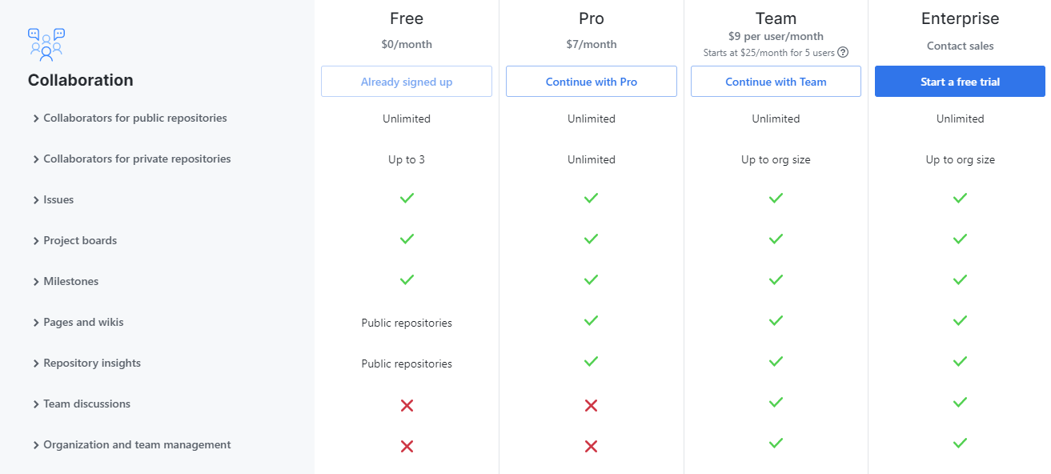
Features comparison

Slide 22
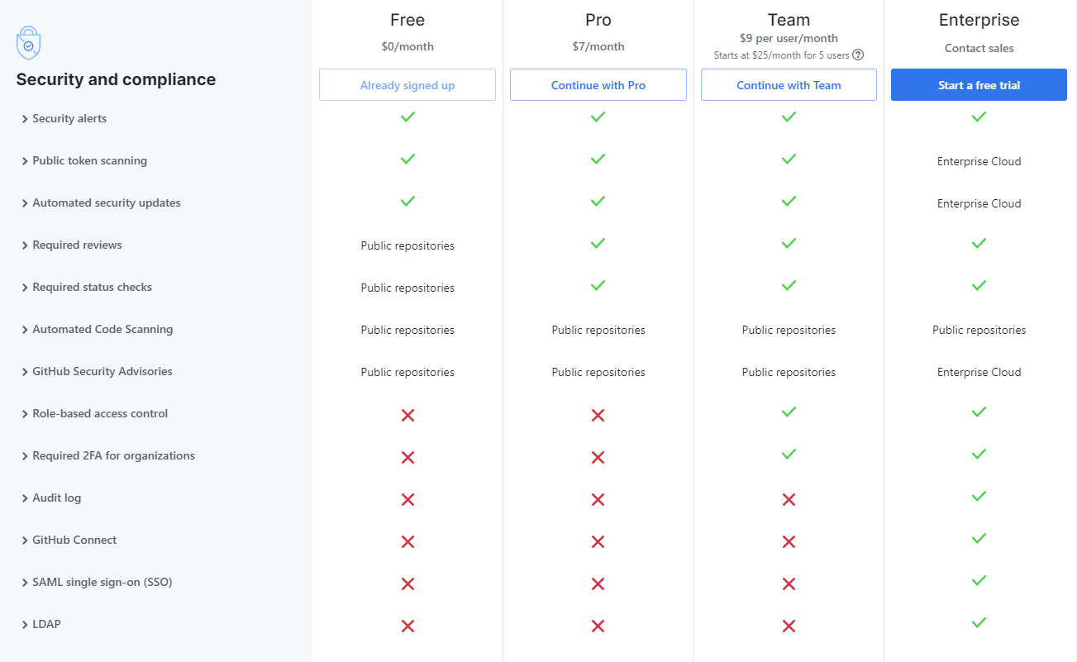
Notes:
Higher price ensures higher security

Slide 23
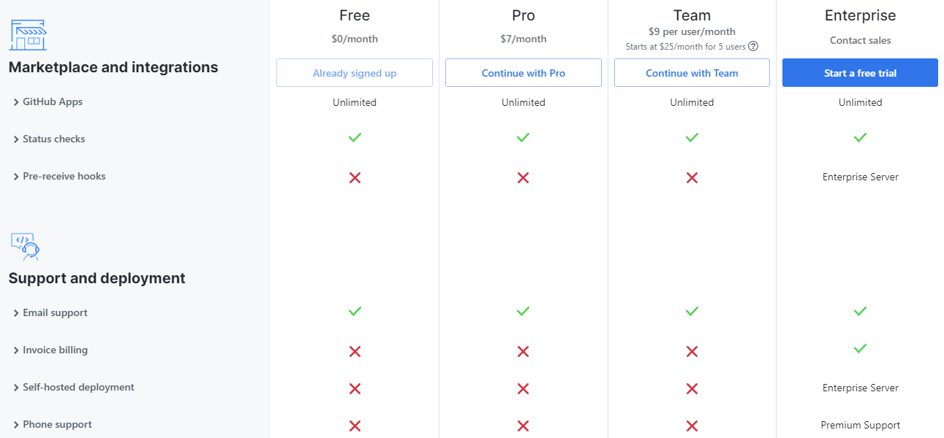
Features comparison

Slide 24
Summary

Slide 25
Thanks for your attention
PLOS PAPER LINK:
https://journals.plos.org/ploscompbiol/article/file?id=10.1371/journal.pcbi.1004668&type=printable

Slide 26
What is Git?

Slide 27
Definitions
Notes:
It is if the VCS takes snap shots of your project in different times and stores them

Slide 28
What is GitHub?
GitHub is a version control repository. A code hosting platform for version control and collaboration. It lets you and others work together on projects from anywhere.
Notes:
On the next slides we would explain the different types of repositories

